Slide 1
CSC479 Introduction to Computer Vision Lecture 3
Review of Linear Algebra, Gaussian Filters, Histogram Equalization
Bei Xiao

Slide 2
Last lecture
Image can represented as a matrix
Point process
Linear filter: convolution

Slide 3
Today’s lecture
A brief review of linear algebra
Gaussian filters
Image Histogram Equalization
Basic image processing tutorial
Homework 2 will be out today.

Slide 4
Essene of linear algebra
Youtube tutorial
https://www.youtube.com/watch?v=kjBOesZCoqc

Slide 5
Basic math of deep learning-based CV
1. Linear Algebra (Today)
http://www.deeplearningbook.org/contents/linear_algebra.html
2. Probability theory (In two weeks).
http://www.deeplearningbook.org/contents/prob.html

Slide 6
Take-home reading
Your textbook: Szesliski, Appendix A.
Geometric introduction to linear algebra.
http://www.cns.nyu.edu/~eero/NOTES/geomLinAlg.pdf
An excellent chapter:
http://www.deeplearningbook.org/contents/linear_algebra.html

Slide 7

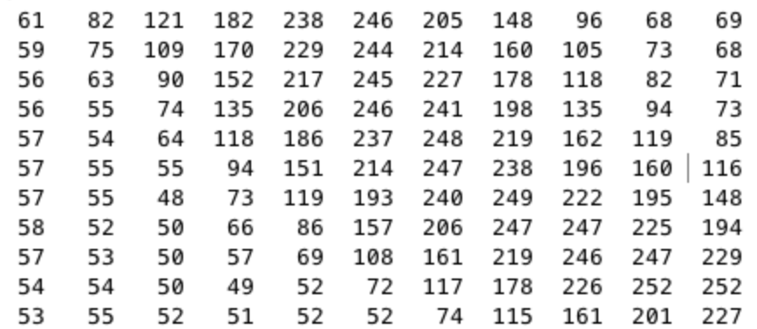
Grayscale Intensity Image as Matrices
row
The pixel P(i,j) has
intensity value of 151
column

Slide 8
8 bit intensity image
8 bit graphics is a method of storing image information in a computer’s memory or in an image file, such that each pixel is represented by one 8-bit type.
The range of 8 bit intensity image is [0 255].

Slide 9
A mini tutorial on linear algebra

Slide 10
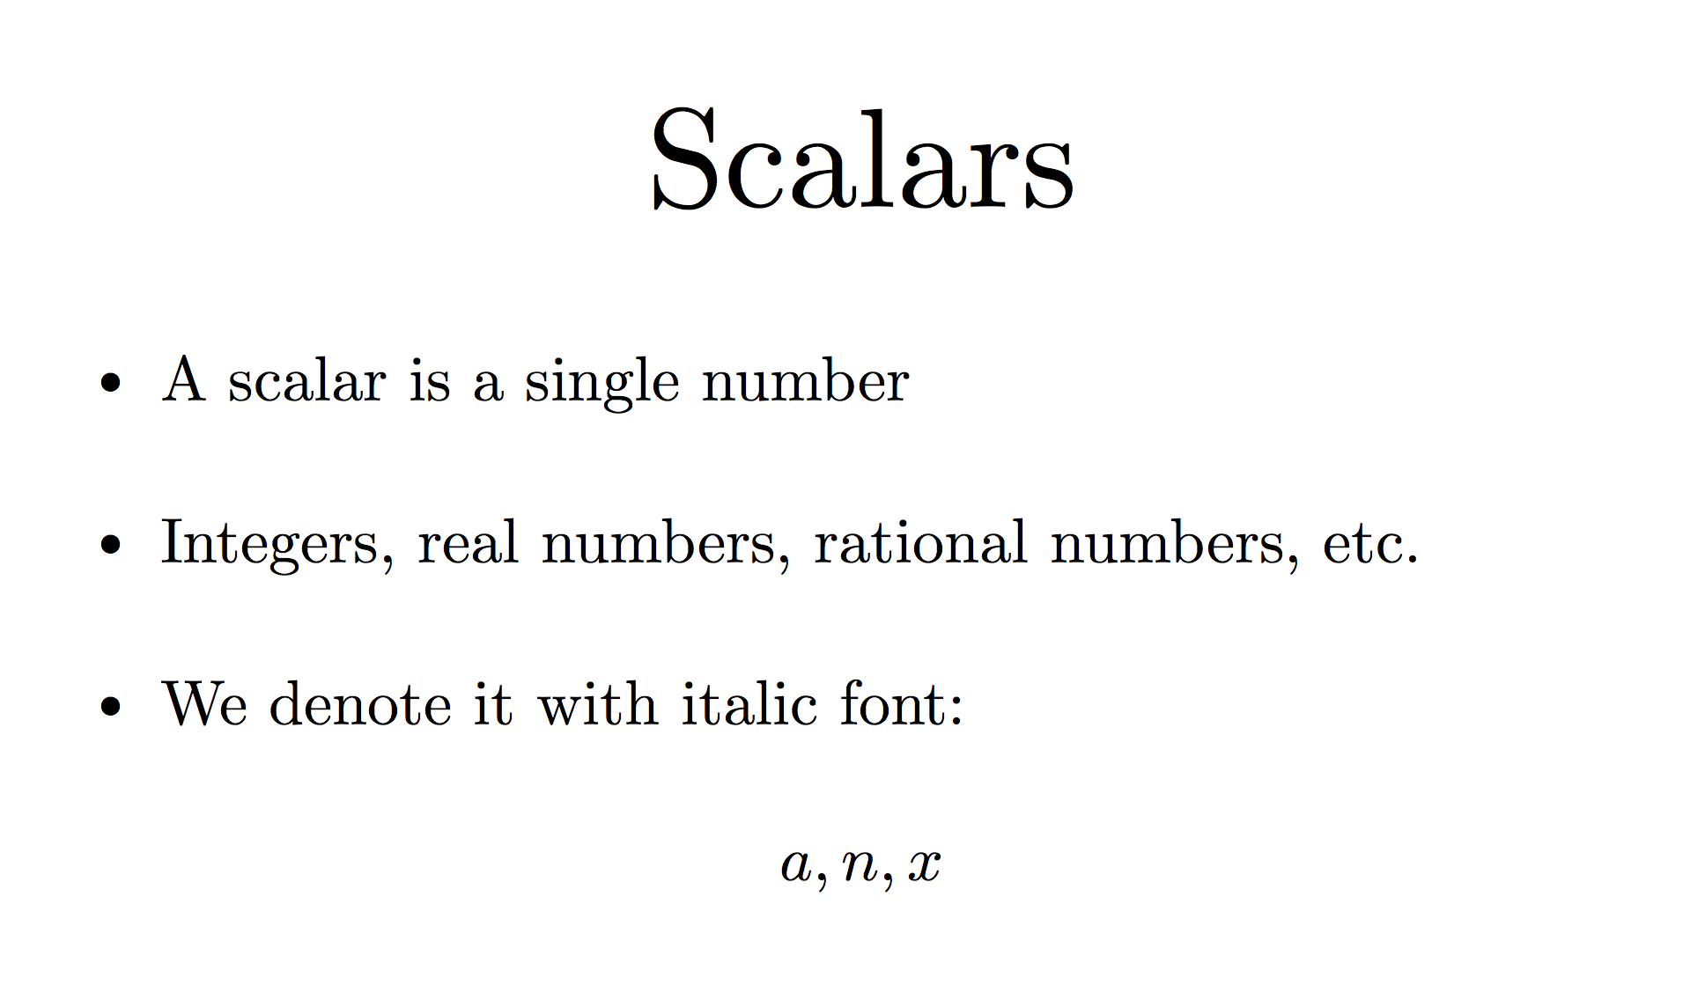
Notes:
Italic notation. Single letter names.

Slide 11
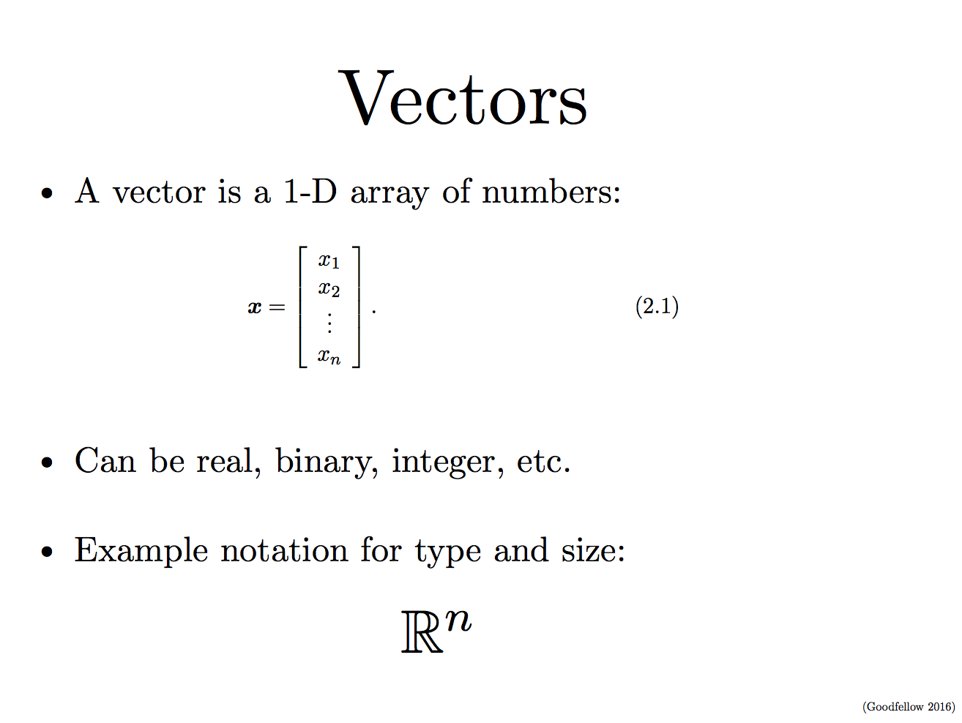
Notes:
We can identify each number by its index.
We can think of vectors as identifying points in space, which each element giving the coordinate along a different axis.
Column vector, row vector.

Slide 12
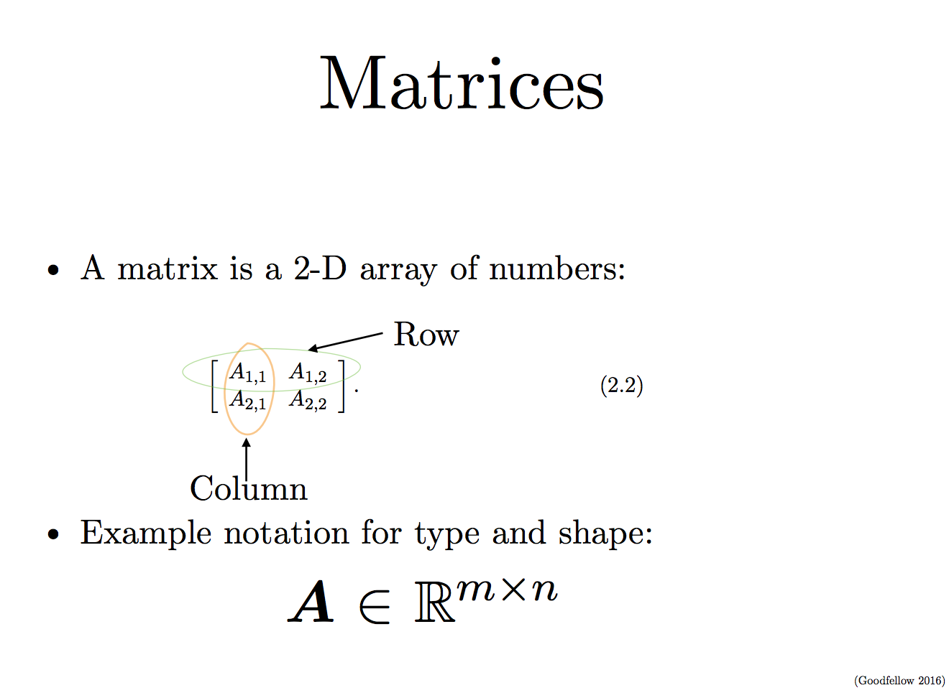
Notes:
Each element is identified by two indices. We usually gave matrices upper case letter names and bold type face.

Slide 13
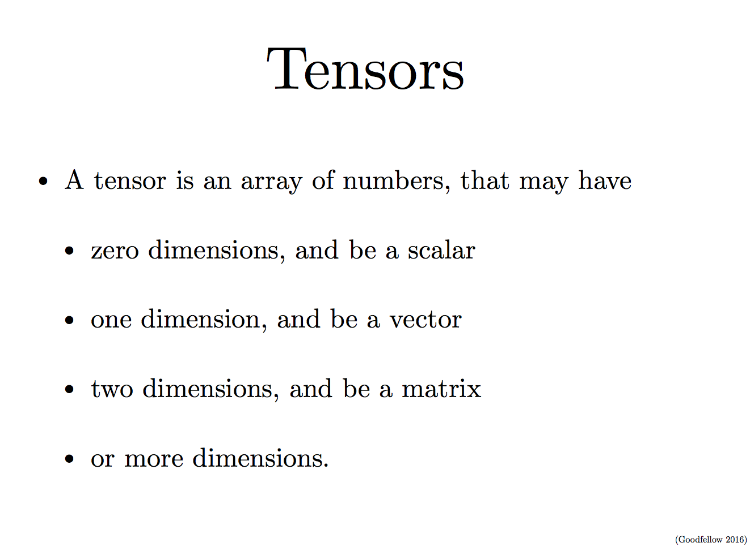
Notes:
An array with more than two axies

Slide 14
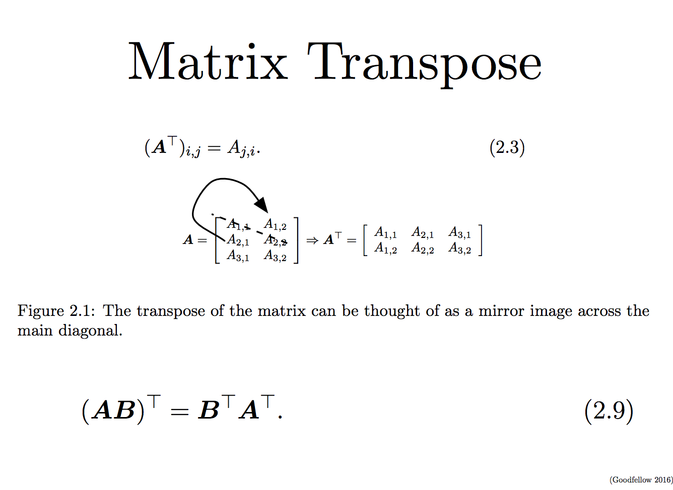
Notes:
The transpose of a matrix is the mirror image of the matrix across a diagonal line, called the main diagonal.
Vectors can be thought of matrix containing one column.

Slide 15
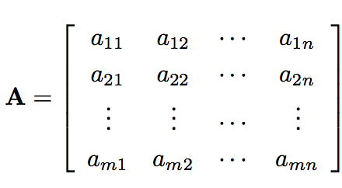
Basic Matrix Operations
ai,j represents the (i,j)

Slide 16
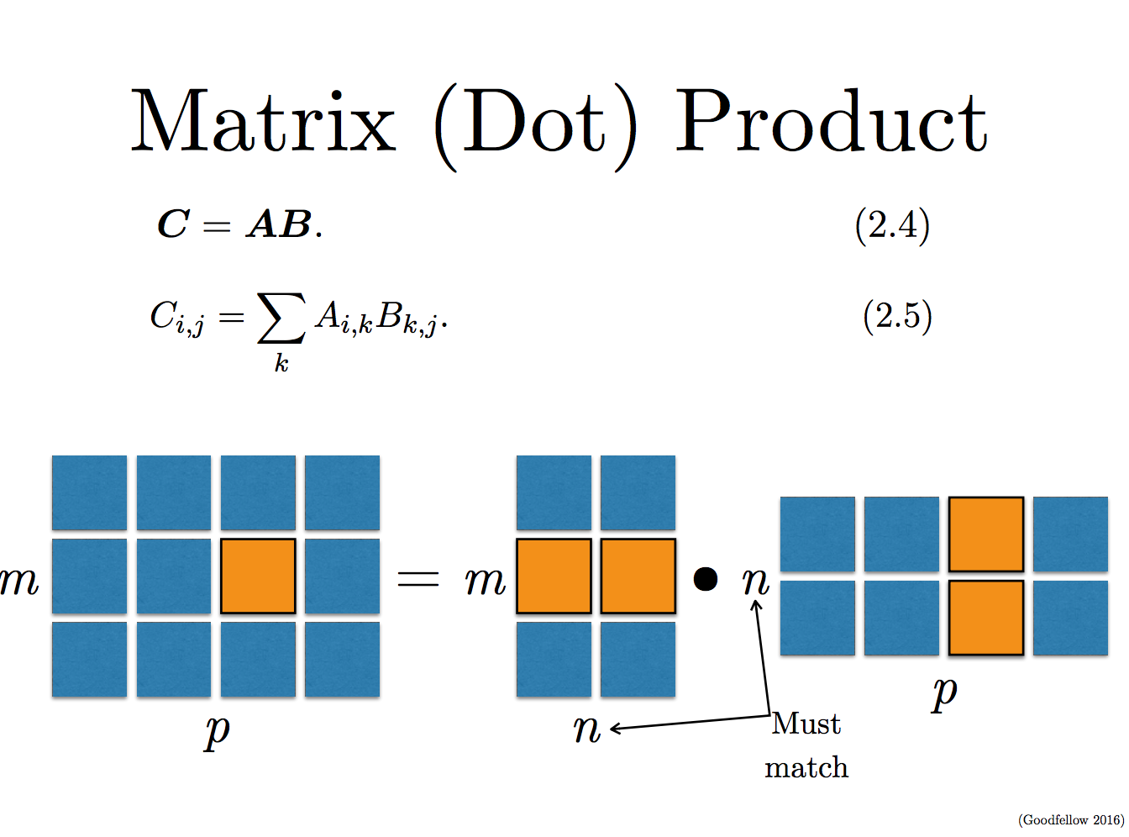

Slide 17
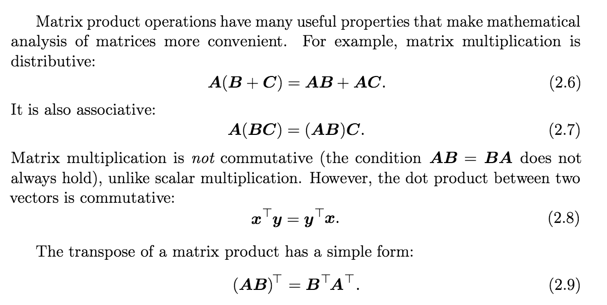

Slide 18
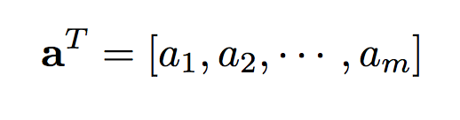
Basic Matrix Operations
Matrix products:
Vector dot product:
Transpose of the column vector is a row vector

Slide 19
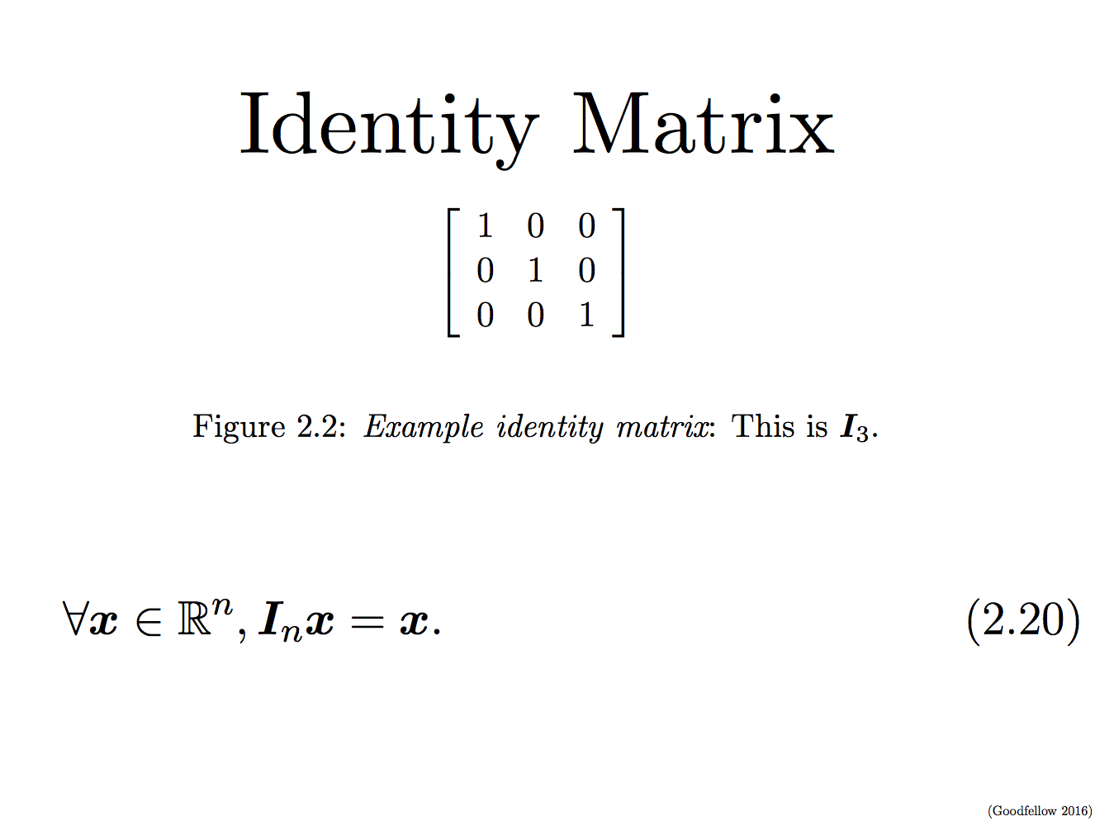

Slide 20
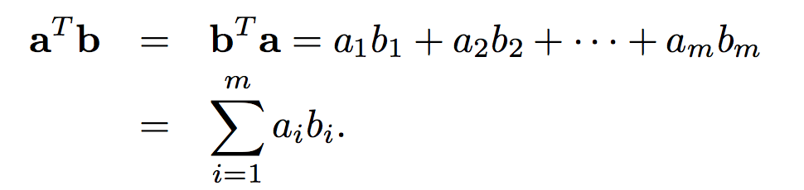
Dot product of two vectors (Algebraic definition)
Dot product is a sum of pair-wise product of components

Slide 21
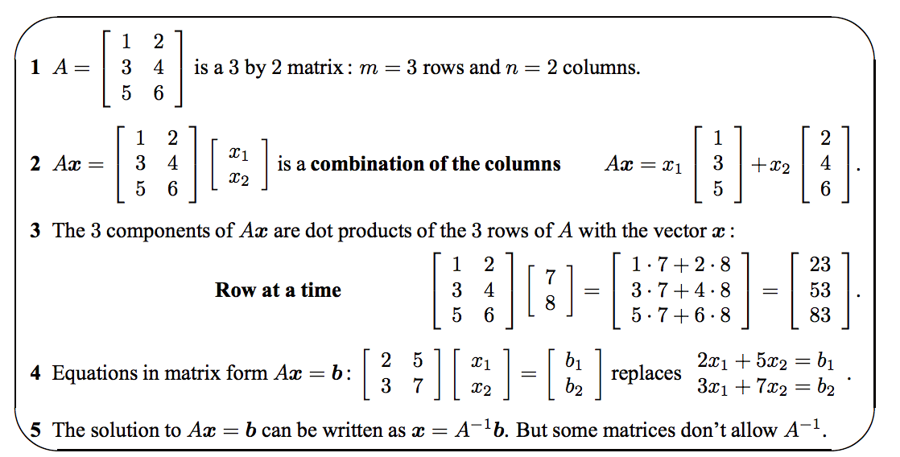

Slide 22
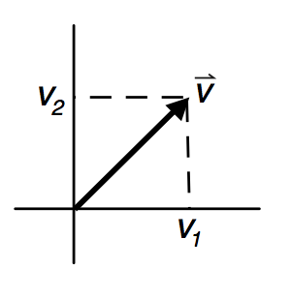
What is a vector?
Vectors of dimension 2 or 3 can be graphically depicted as arrows, with the tail at the origin and the head at the coordinate location specific by the vector components.
Vector has a length and a direction. The norm or length is defined as:

Slide 23
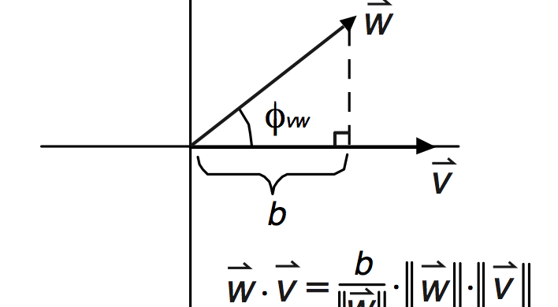
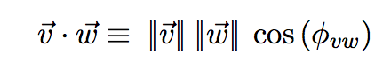
Dot product (inner) of two vectors (Geometric definition)
Φ is the angle between the two vectors

Slide 24
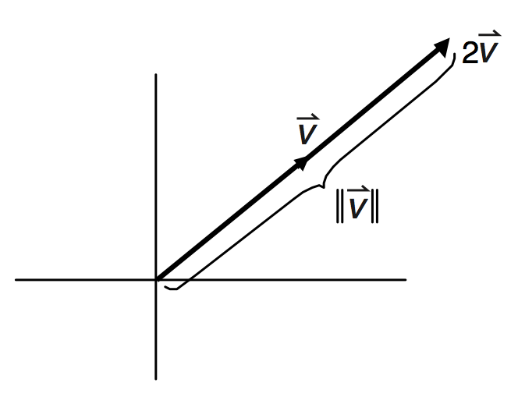
Scalar product
Multiplying a vector by a scalar simply changes the length of the vector by that factor

Slide 25
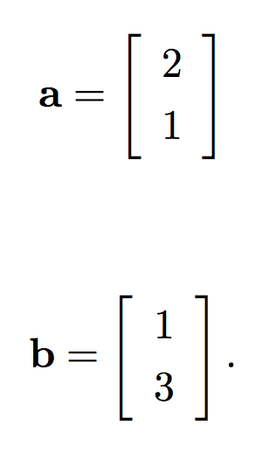
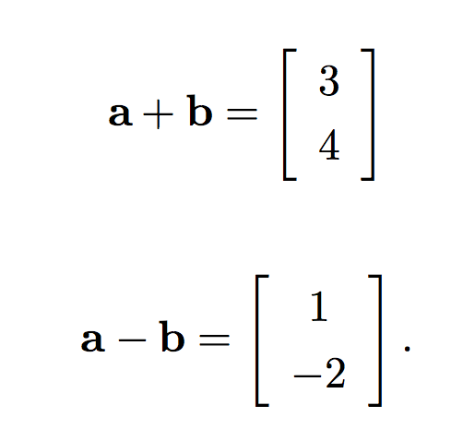
Vector Space
A vector space is a collection of vectors that is closed under linear combination.

Slide 26
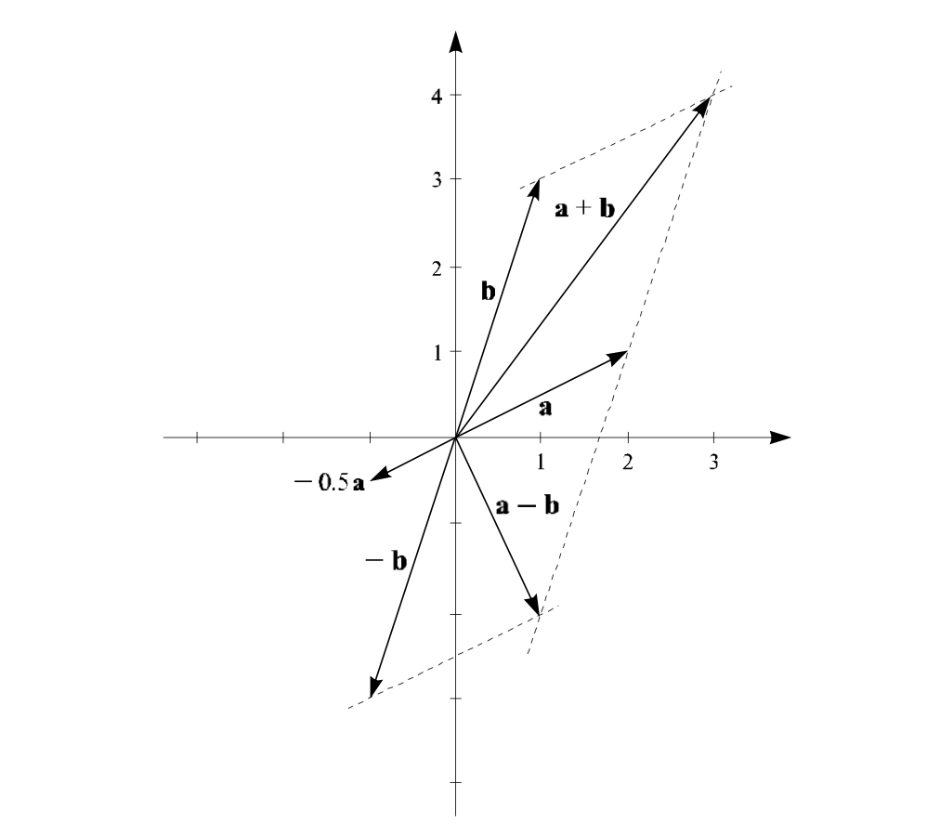
Vector Space (geometric)

Slide 27
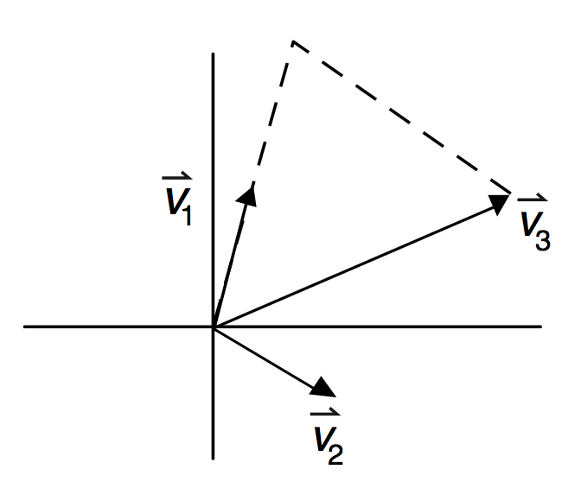
Vector Space (geometric)

Slide 28
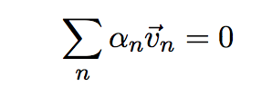
Basis
A set of vectors in a vector space V is called a basis, or a set of basis vectors.
A basis B of a vector space V is linearly independent if and only if:
A basis for a vector space is linearly independent spanning set.

Slide 29
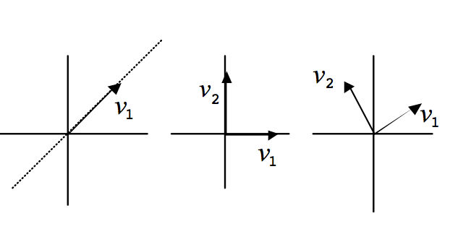
Basis vectors

Slide 30
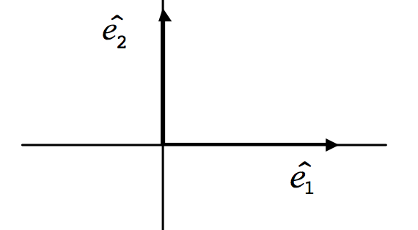
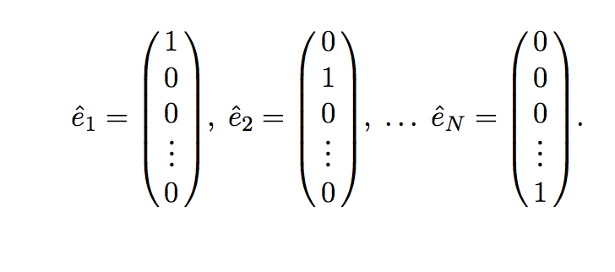
Standard Basis (unit vectors)

Slide 31
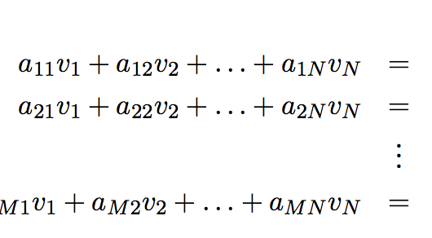
Linear Equations
If we put the variables v_{n} and constant b_{m} into vectors and the constants am into a matrix A, these equations maybe written more compactly:
To solve:

Slide 32
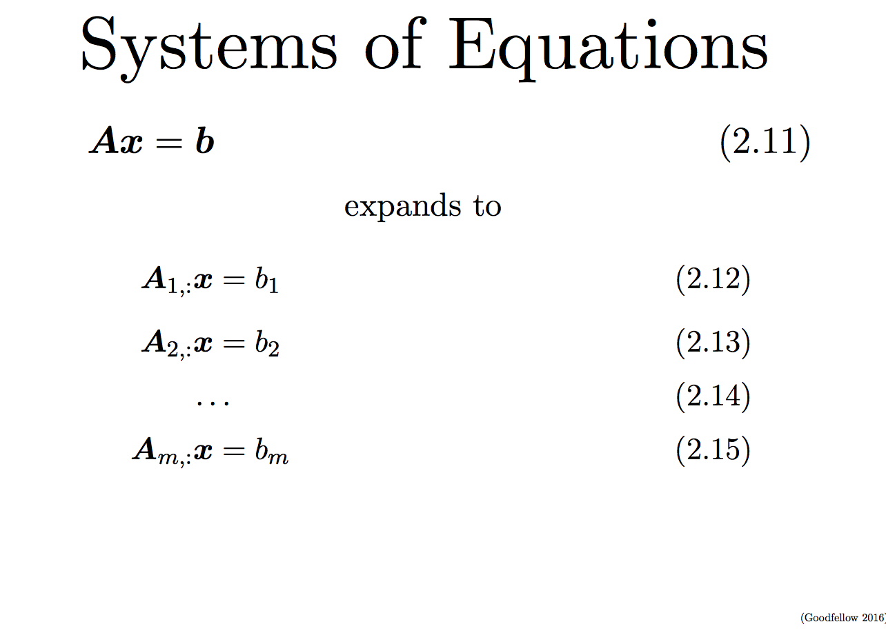

Slide 33
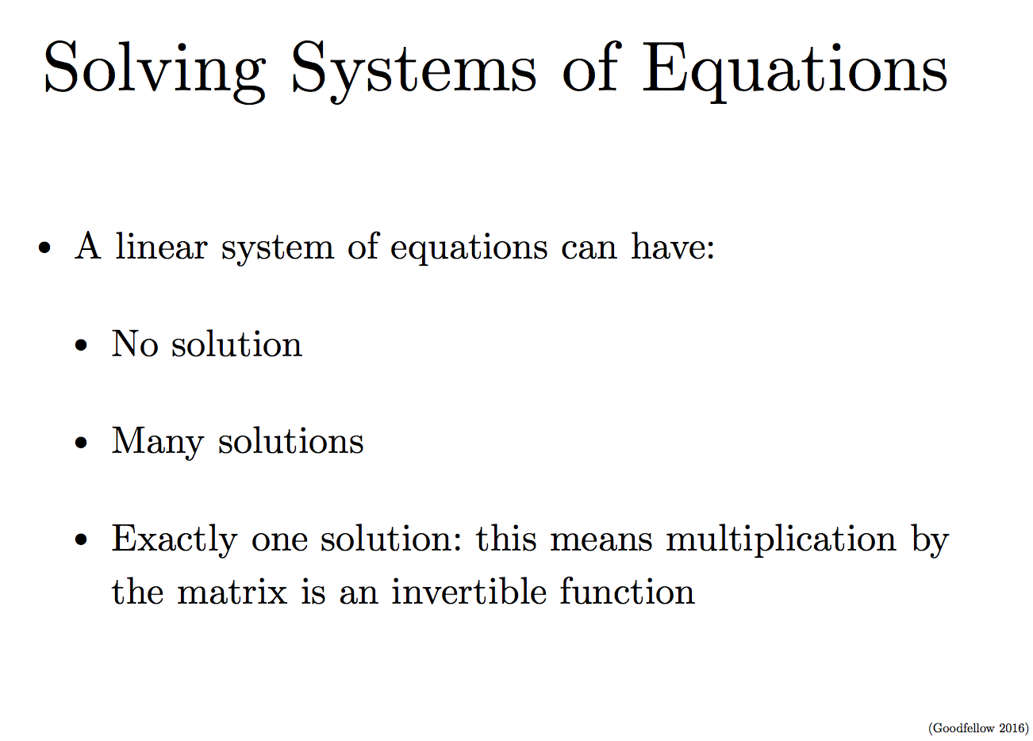

Slide 34
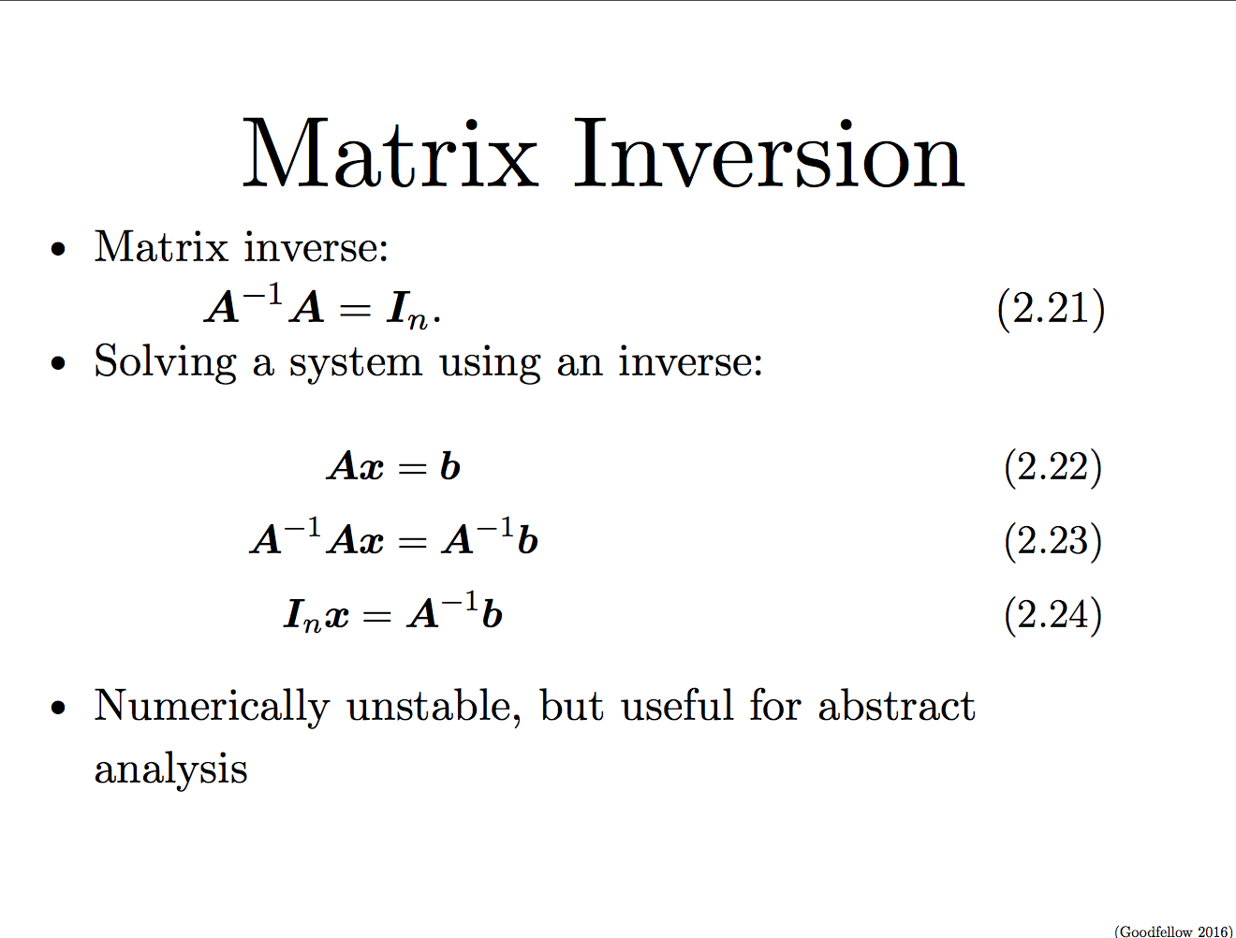

Slide 35
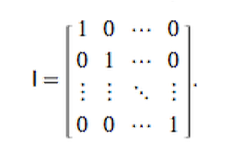
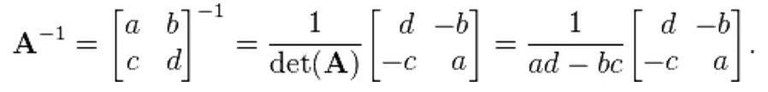
Matrix Inverse
Matrix Inverse:
A⁻¹A = I, I is identity matrix
Inversion of a 2× 2 matrix
http://mathworld.wolfram.com/MatrixInverse.html

Slide 36
The determinant (det(A))
The determinant of a square matrix, denoted
det(A), is a function that maps matrices to real scalars.
Geometrically, it can be viewed as the volume scaling factor of the linear transformation described by the matrix.

Slide 37
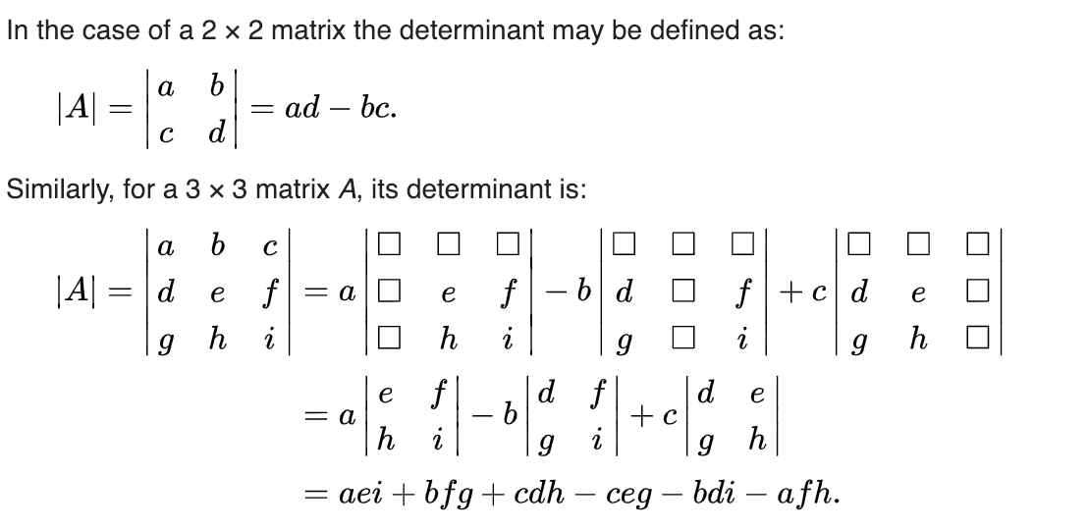
The determinant (det(A))

Slide 38
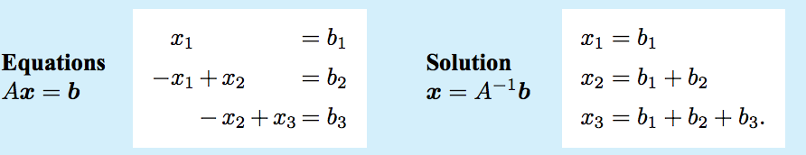
Solving linear equations

Slide 39
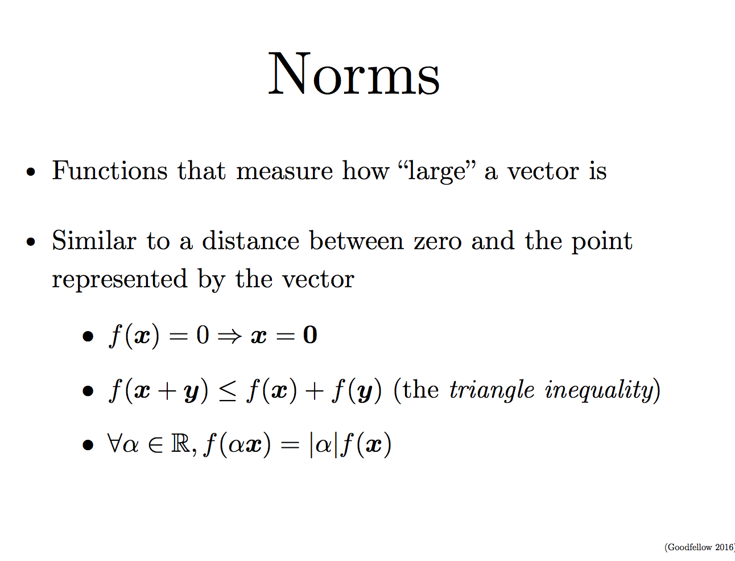

Slide 40
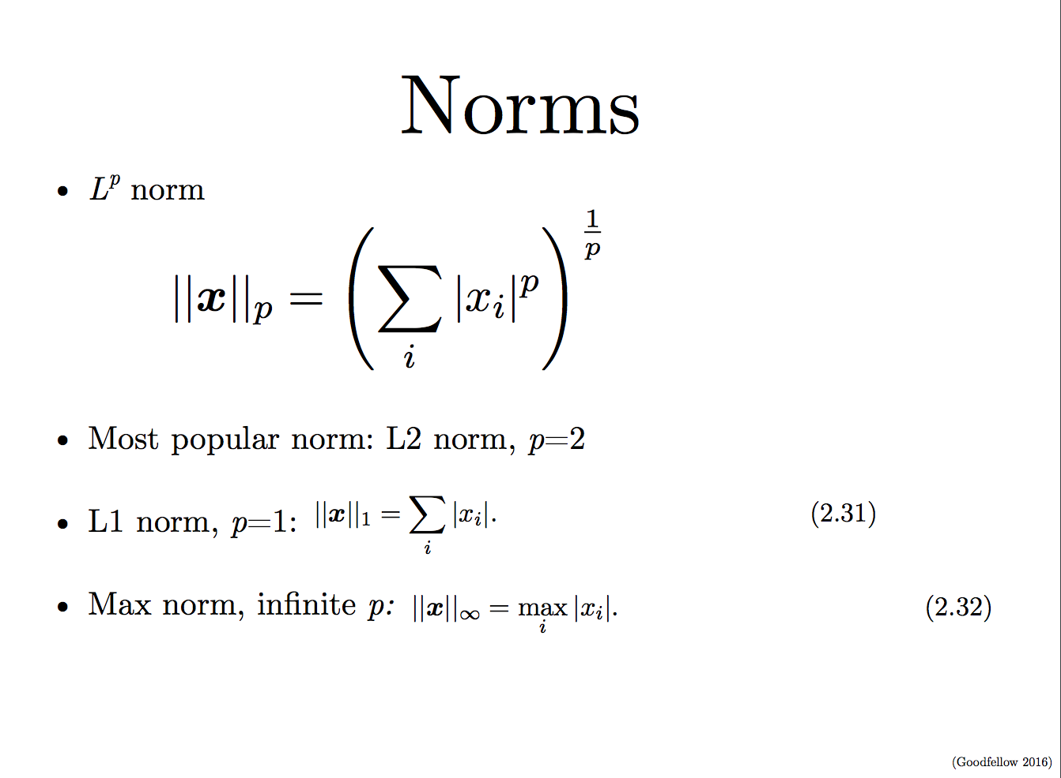

Slide 41
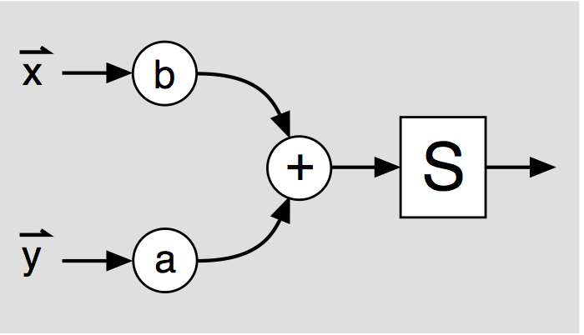
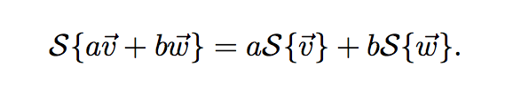
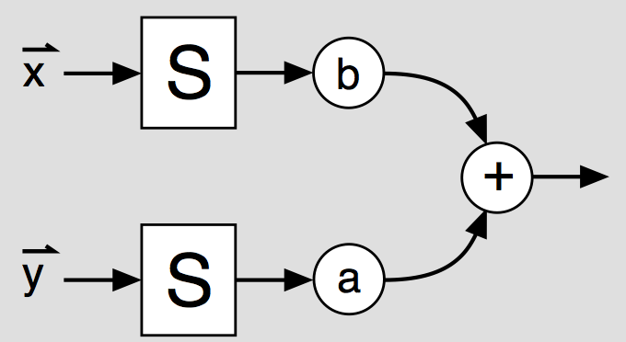
Linear System
A linear system S transforms vectors in one vector space into those of another vector space,
in such a way that it obeys the principle of superposition:

Slide 42
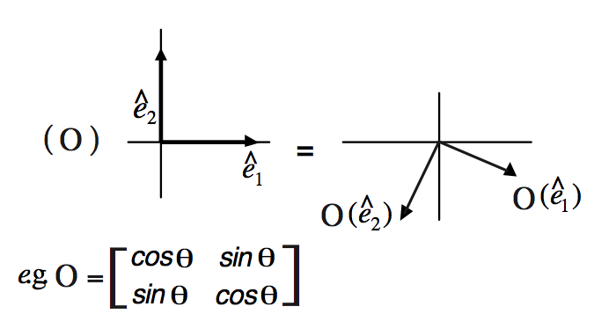
Orthogonal marix
O^{T}O = I, transpose of the matrix mulitplied by itself gives the identity matrix

Slide 43
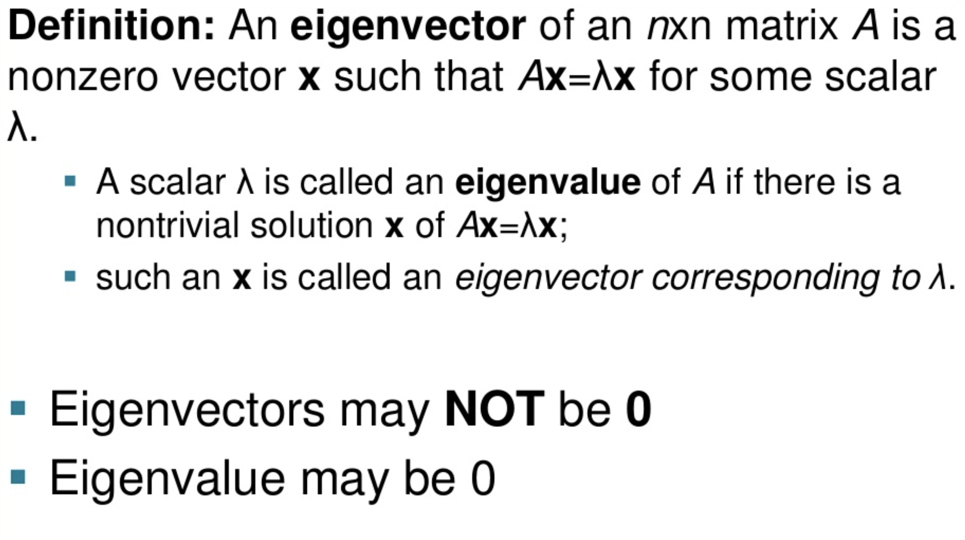
Eigen values and decomposition

Slide 44
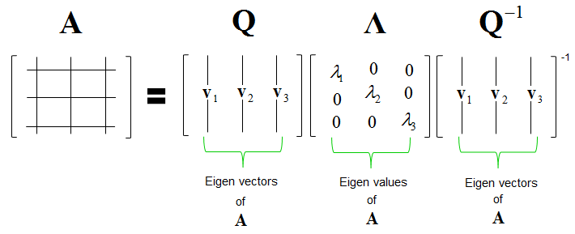
Eigen values and decomposition
Any real symmetric matrix A is guaranteed to have an eigen decomposition, but the decomposition might be unique.
If any two or more eigenvectorsbshare the same eigenvalue, then any set of orthogonal vectors lying in their span are also eigenvectors with that eigenvalue, and we could equivalently choose an Qb using those eigenvectors instead. By convention, we usually sort the entries ofbΛb in descending order.

Slide 45
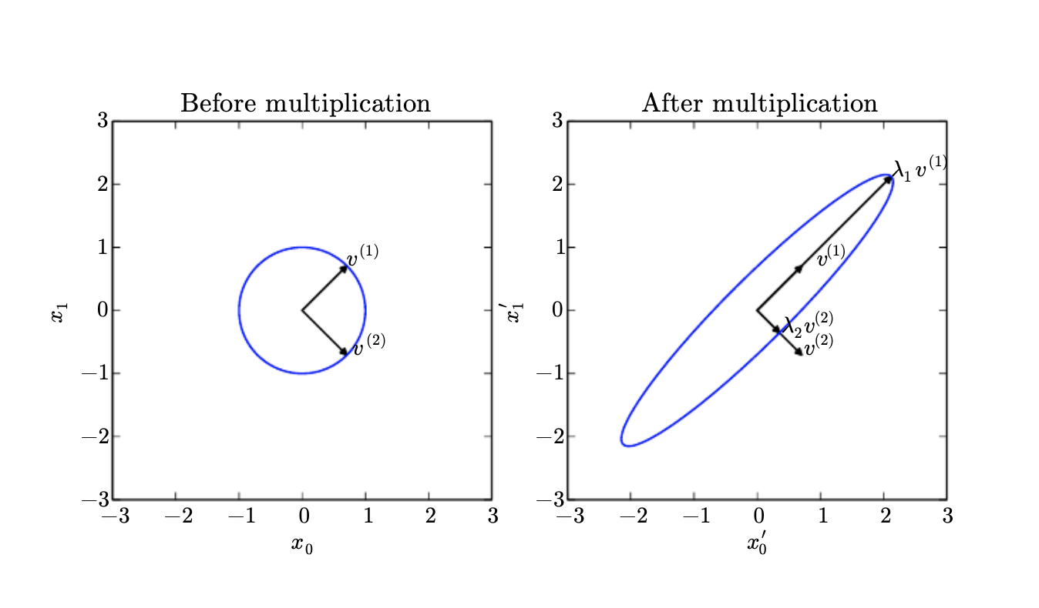
Eigen values and decomposition

Slide 46
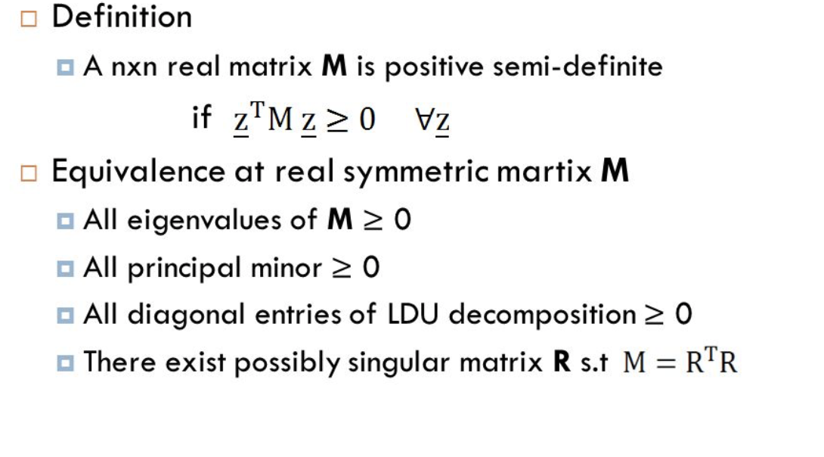
Positive semi-definite matrix

Slide 47
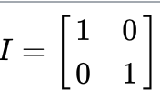
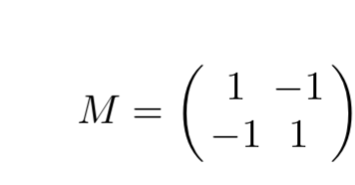
Quiz
Is the identity matrix positive semi-definite?
How about this matrix? How to check?

Slide 48
Linear algebra with Python
Arrays
import numpy as np
from numpy.linalg import *
# create a single array
a = np.array([1, 4, 5, 8], float)
# create a multidimensional arary
a = np.array([[1, 2, 3], [4, 5, 6]], float)

Slide 49
Matrix multiplication Numpy
>>> a = np.array([[1, 0], ... [0, 1]])
>>> b = np.array([[4, 1], ... [2, 2]]
>>> np.matmul(a, b)
array([[4, 1], [2, 2]])

Slide 50
broadcasting
>>> a = np.arange(2 * 2 * 4).reshape((2, 2, 4))
array([[[ 0, 1, 2, 3],
[ 4, 5, 6, 7]],
[[ 8, 9, 10, 11],
[12, 13, 14, 15]]])
>>> b = np.arange(2 * 2 * 4).reshape((2, 4, 2))
>>> np.matmul(a,b).shape (2, 2, 2)
>>> np.matmul(a, b)[0, 1, 1]
98

Slide 51
np.dot()
If both a and b are 1-D arrays, it is inner product of vectors (without complex conjugation).
If both a and b are 2-D arrays, it is matrix multiplication, but using matmul or a @ b is preferred.

Slide 52
Eigenvalue decomposition: np.linalg.eig
>>> from numpy import linalg as LA
>>> a =np.diag((1,2,3))
>>> w, v = LA.eig(a)
>>> w
array([1., 2., 3.])
>>> v
array([[1., 0., 0.],
[0., 1., 0.],
[0., 0., 1.]])
>>>

Slide 53
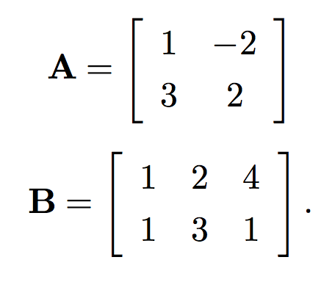
Exercise:
what is the result of the following matrix product:
First do this by hand and then check your answer with Numpy.

Slide 54
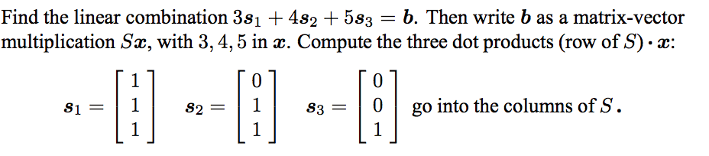
Take-home exercise: Check next class!!!

Slide 55
Back to image processing

Slide 56
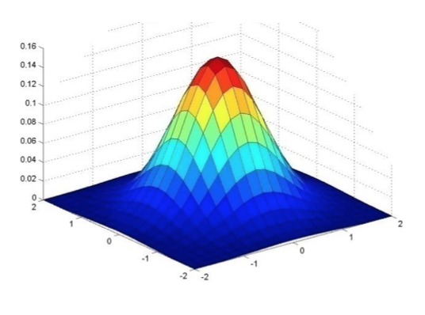
Gaussian Filter
Gaussian = normal distribution function

Slide 57
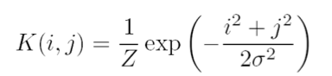
Gaussian Filter
Gaussian = normal distribution function

Slide 58
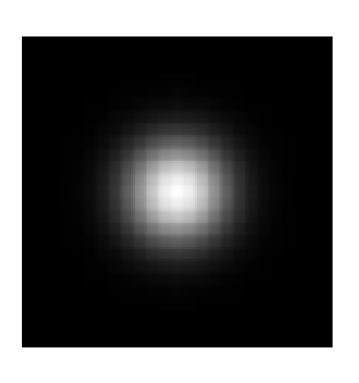
Gaussian Filter
Gaussian = normal distribution function

Slide 59

Gaussian Filter
Gaussian = normal distribution function

Slide 60




Gaussian filter with different σ
Original
σ = 3
σ = 5
σ = 7

Slide 61
Gaussian Filter
Remove “high-frequency” components from image (low-pass filter)
Images become more smooth
Convolution with self is another Gaussian
So can smooth with small-width kernel, repeat and get same result as larger-width kernel would have.
Convolving two times with kernel width σ is same as convolving once with kernel width σ/2 (Can you proof this?)

Slide 62

Separability of the Gaussian filter
The 2D Gaussian can be expressed as the product of two functions, one function of x and the other the function of y.
In this case, the two functions are (identical) 1D Gaussian.

Slide 63

Notes:
>>> a = np.array([[1],[2],[1]])
>>> b= np.array([[1],[2],[1]])
>>> np.outer(a,b)
array([[1, 2, 1],
[2, 4, 2],
[1, 2, 1]])

Slide 64

Matrix Multiplication
Notes:
>>> a = np.array([[1],[2],[1]])
>>> b= np.array([[1],[2],[1]])
>>> np.outer(a,b)
array([[1, 2, 1],
[2, 4, 2],
[1, 2, 1]])

Slide 65


Slide 66
Why is separability useful?
The process of performing a convolution requires K^2 operations per pixel
Suppose v and h are horizontal and vertical kernels.
K = vh^T
2K operations per pixel!

Slide 67
Exercise
Open Lecture 3 and download all the codes and images.
1. Can you write your own function unsharp_mask that takes a blurred image and make a sharper?
2. Can you write a filter that is unsharpmask? That you only have to convolve the image once!
You can use the images in the folder or any other images you can find. Make sure their sizes are not too big.
See lecture notes for details.
Hint: Use filters.gaussian_filter(im,size).

Slide 68

Image Histogram Equalization
We have a low-contrast image:

Slide 69

Image Histogram Equalization
We would like to increase the contrast

Slide 70


What is a histogram

Slide 71
Image Histogram Equalization
We have a low-contrast image:
Limited image range

Slide 72

Image Histogram Equalization
What we want is a histogram that covers the whole range of [0,255], but the shape must be preserved!
Ideal histogram

Slide 73

Mini detour of Probability Theory
PDF, density of a continuous random variable, is a function that describes the relative likelihood for this random variable to take on a given value.

Slide 74

Mini detour of Probability Theory
cumulative distribution function (CDF), describes the probability that a real-valued random variable X with a given probability distribution will be found to have a value less than or equal to x.

Slide 75
How does it work?
Mapping one distribution to another distribution (a wider and more uniform of intensity values) so that the intensity values are spreading over the whole range
The mapping should be the cumulative density function (CDF).

Slide 76



Stretching the CDF
Transform
Before
After

Slide 77




Image Histogram Equalization
Notice the “shape” of the histogram is preserved!
Same number of pixels
In each bin!

Slide 78
Questions
Why don’t we do the equalization directly on the histograms? What will happen to the image if it has a perfectly flat histograms?
What is CDF? Why are there steps (zig-zags) on the CDF?
How to make sure the “shape” of the PDF is preserved in the transformation?

Slide 79

Let’s look at in more details
We start with a gray-scale jpeg image of 8 by 8
https://en.wikipedia.org/wiki/Histogram_equalization

Slide 80

Let’s look at in more details
The histograms for this image (8 by 8 pixels) is shown in the following table (intensity that has zero pixels are skipped:

Slide 81
Let’s look at in more details
The cumulative distribution function (CDF) is shown below
Value | cdf | scaled cdf
52 | 1 | 0
55 | 4
58 | 6
59 | 9
60 | 10
61 | 14
62 | 15
… | …
154 | 64 | 255
This cdf shows that the min value in the subimage is 52 and max is 154. The cdf of value 154 corresponding to the total number of pixels (64)
Number of pixels

Slide 82

Let’s look at in more details
How do we compute the normalized CDF?
Cdf(v): original cdf of pixel v
Cdfmin: minimum non-zero vale of the cdf
M×N: number of pixels, e.g. 64 (8x8)
L: 256

Slide 83
Quiz:
How do we compute normalized CDF of pixel 62?
Value | cdf | scaled cdf
52 | 1 | 0
55 | 4
58 | 6
59 | 9
60 | 10
61 | 14
62 | 15 | ?
… | …
154 | 64 | 255

Slide 84
Quiz:
How do we compute normalized CDF of pixel 62?
Value | cdf | scaled cdf
52 | 1 | 0
55 | 4
58 | 6
59 | 9
60 | 10
61 | 14
62 | 15 | ?
… | …
154 | 64 | 255
H(62) = round((15-1)/63*255)
= 57

Slide 85
Let’s look at in more details
The cumulative distribution function (CDF) is shown below
Value | cdf | scaled cdf
52 | 1 | 0
55 | 4 | 12
58 | 6 | 22
59 | 9 | 32
60 | 10 | 36
61 | 14 | 53
62 | 15 | 57
… | … | …
154 | 64 | 255

Slide 86

Let’s look at in more details
Now we can directly map the scaled cdf back to pixel values using the look up table we derived above
52
55
61
66

Slide 87

Let’s look at in more details

Slide 88
Let’s look at in more details

Slide 89
Homework 2: histogram equalization
Hint:
#Compute cdf in Python:
np.histogram(im.flatten(),nbr_bins,normed=True)
cdf = imhist.cumsum()
# normalize
cdf = 255 * cdf / cdf[-1]
# Using linear interpretation of cdf to find new pixels.
im2 = np.interp(im.flatten(),bins[:-1],cdf)

Slide 90
Next class
Bordering effect
Image Derivatives

